Slide 1
The Public Perception of AI
Focusing on Work and Education
Hanning and Isabella
Notes:
Isabella

Slide 2
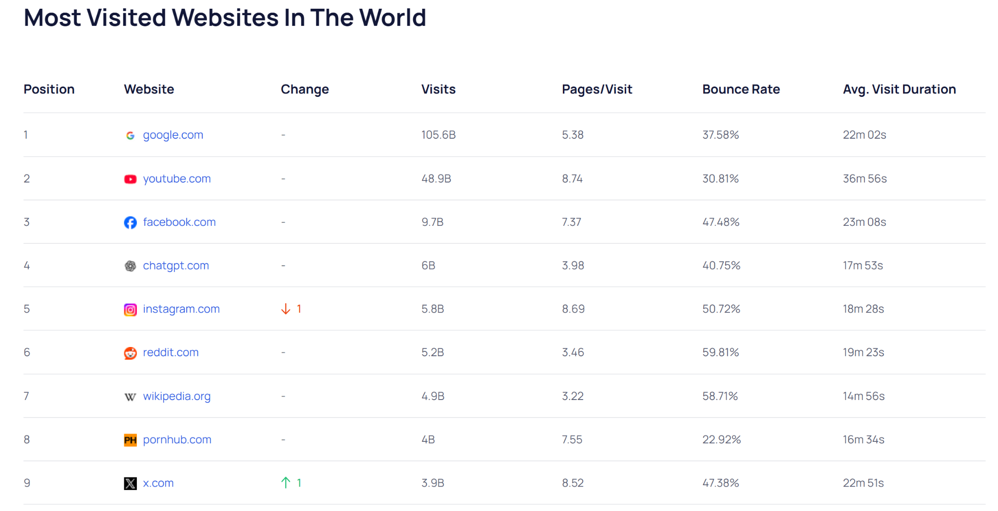
Background
After ChatGPT debuted to the public on Nov 30,2022, the world has been reshaped dramatically.
Right now, ChatGPT has become the top 5 most popular websites in the world. All AI companies including Gemini, Claude, Deepseek, are competing against each other to occupy not only the technology sector, but also permeate into our daily lives.
https://analytics.explodingtopics.com/website
Notes:
annie

Slide 3
Even with the rapid development of AI technology, what are the real feelings of the general public? Is it excitement or fear?
Notes:
annie

Slide 4
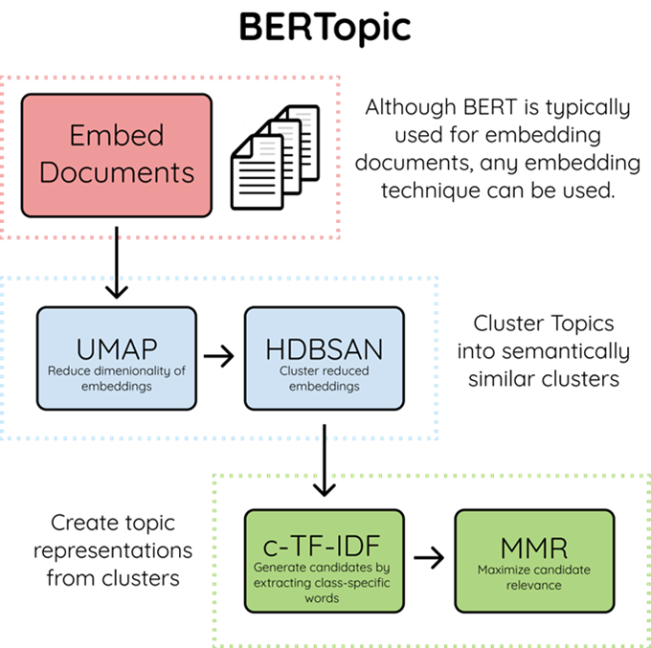
Dataset and Methodology
Data collection using the Bluesky API
Filtered down the data by topics: work and education
Topic modeling
Sentiment analysis
Created visualizations and analyzed them

Slide 5
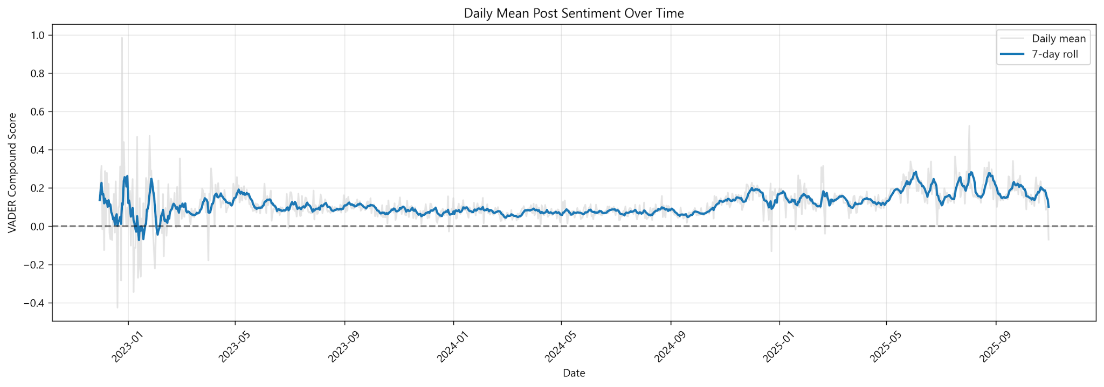
General Picture
General picture on the Public Perception over time
Notes:
isabella

Slide 6
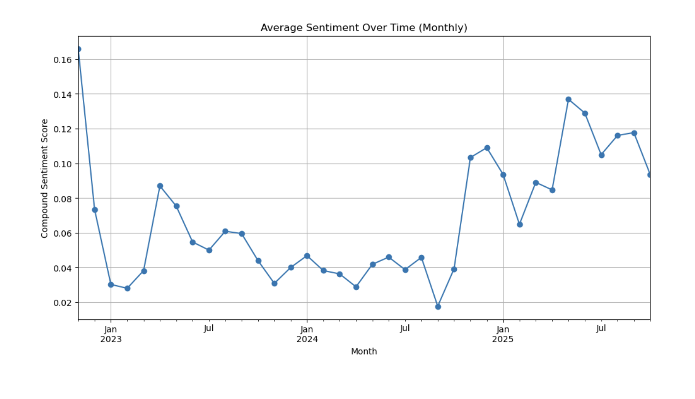
General Picture
Notes:
isabella

Slide 7
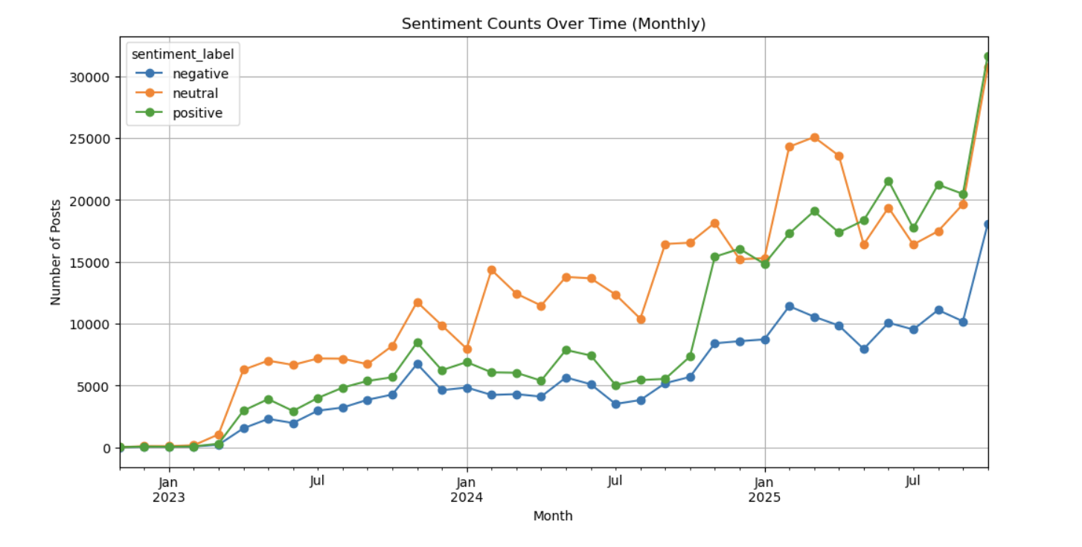
General Picture
Notes:
isabella

Slide 8
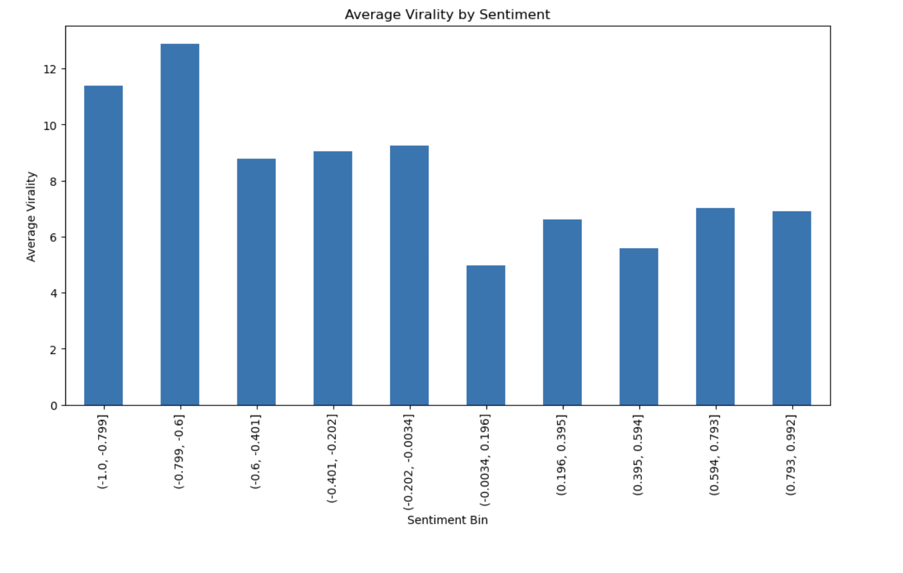
Notes:
isabella

Slide 9
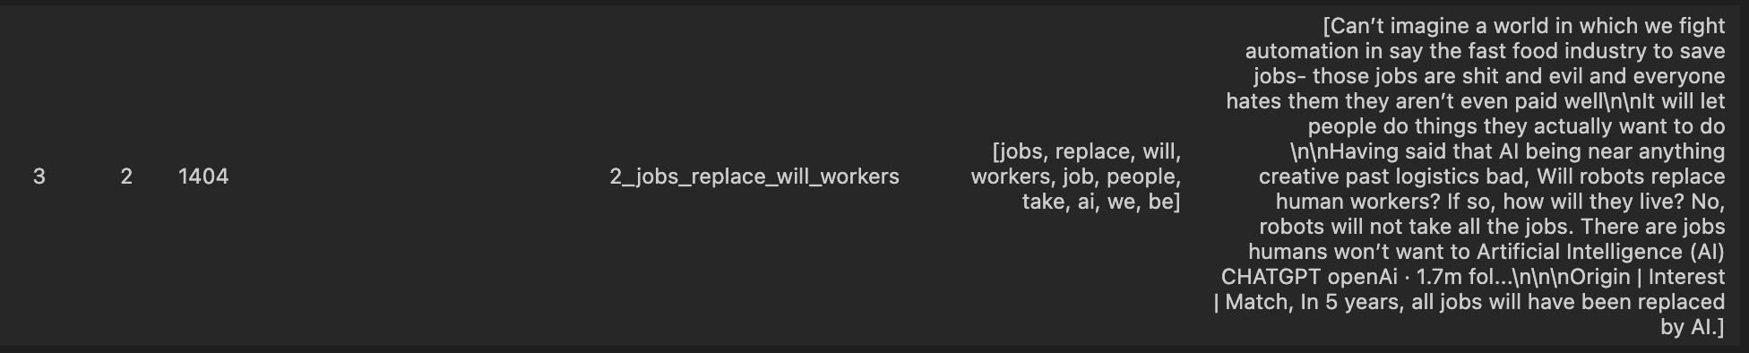
Filtered by Job related words(SAMPLE 2000 IN 12000)
Notes:
annie

Slide 10
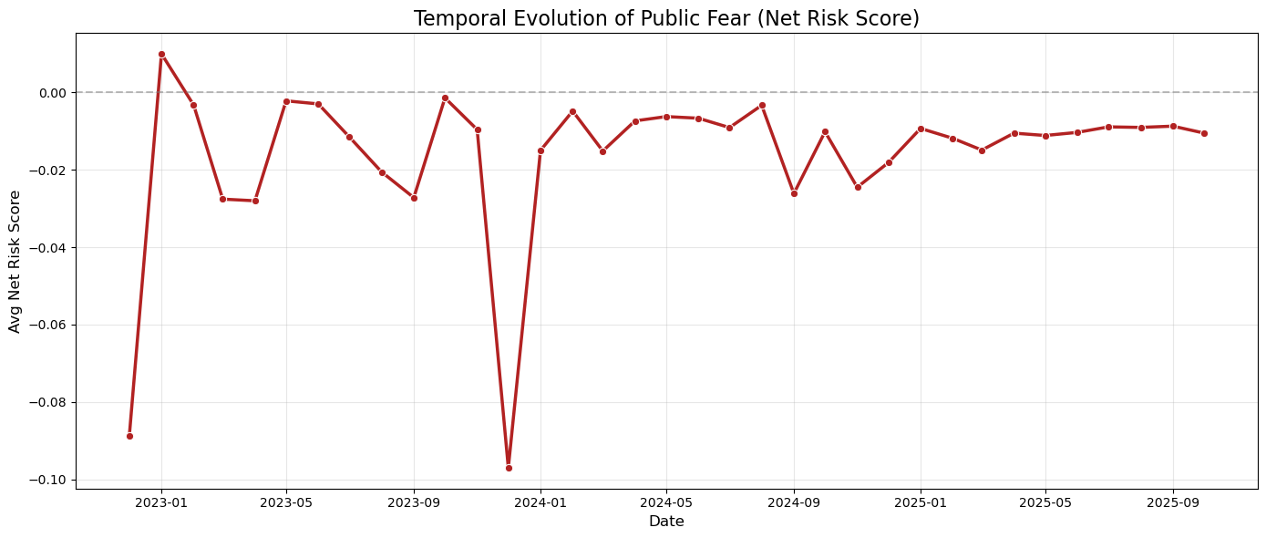
Filtered by Job related words(ALL 12000)
Net Risk = (Fear + Nervousness) - Optimism
Notes:
annie

Slide 11
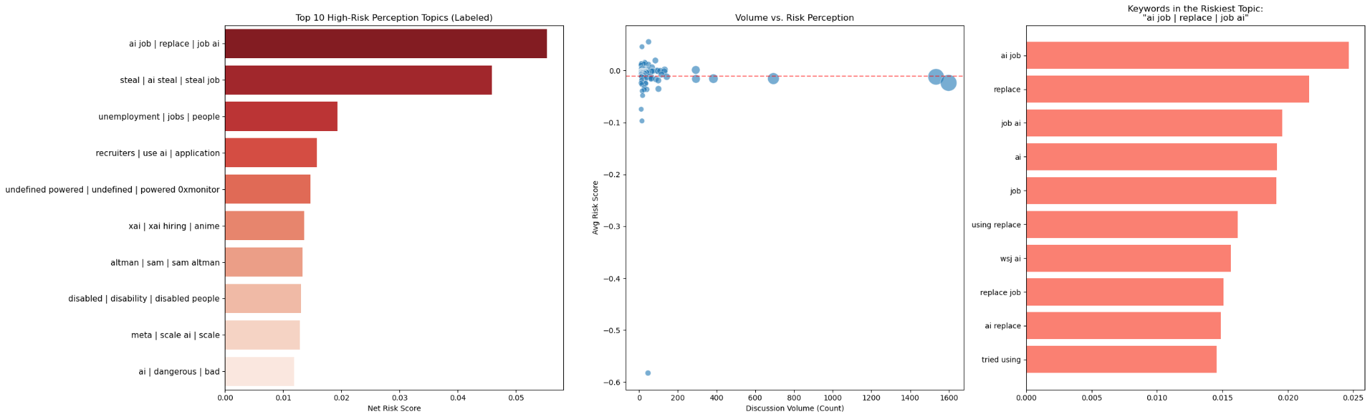
Filtered by Job related words(ALL 12000)
Notes:
annie

Slide 12
Filtered by Job related words(ALL 12000)
Notes:
annie

Slide 13
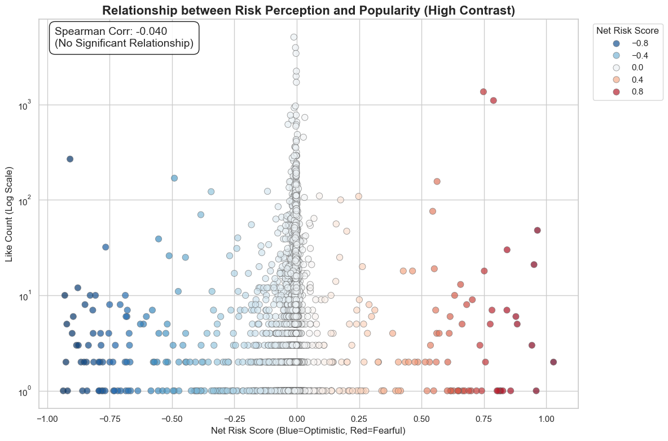
Filtered by Job related words(ALL 12000)
Notes:
annie

Slide 14
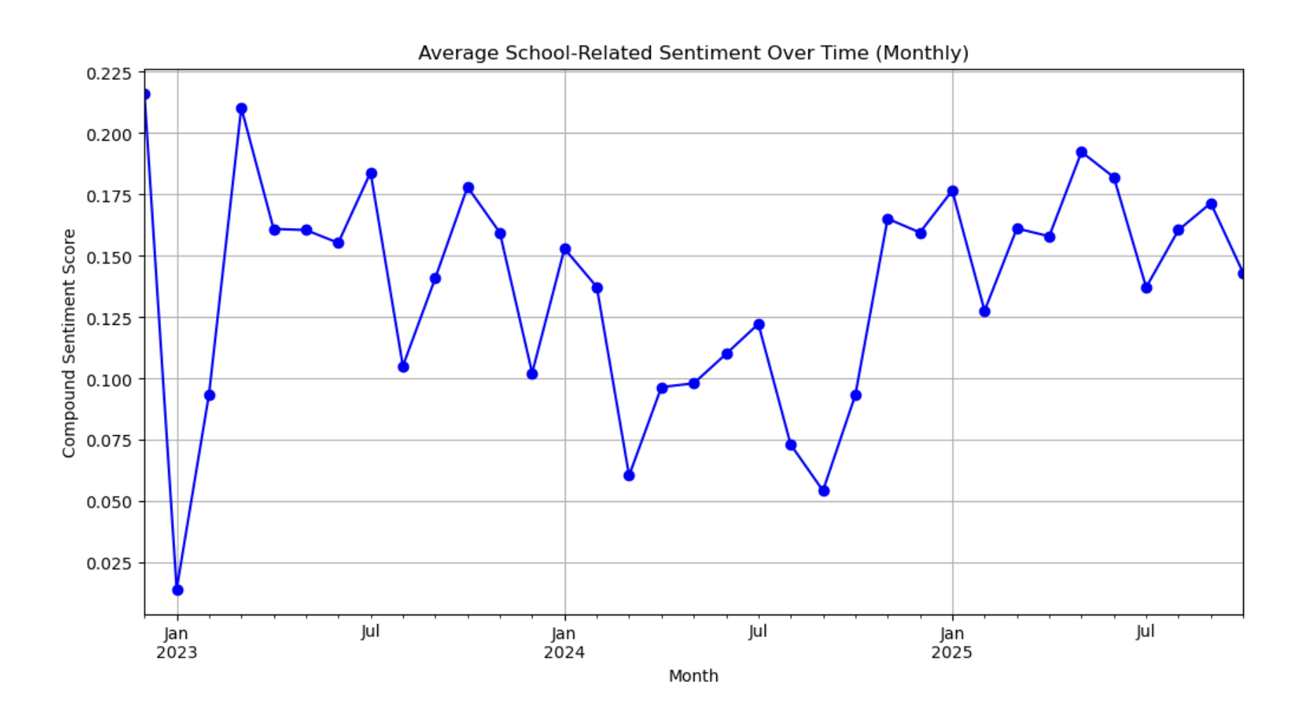
Filter by School related words
Notes:
isabella

Slide 15
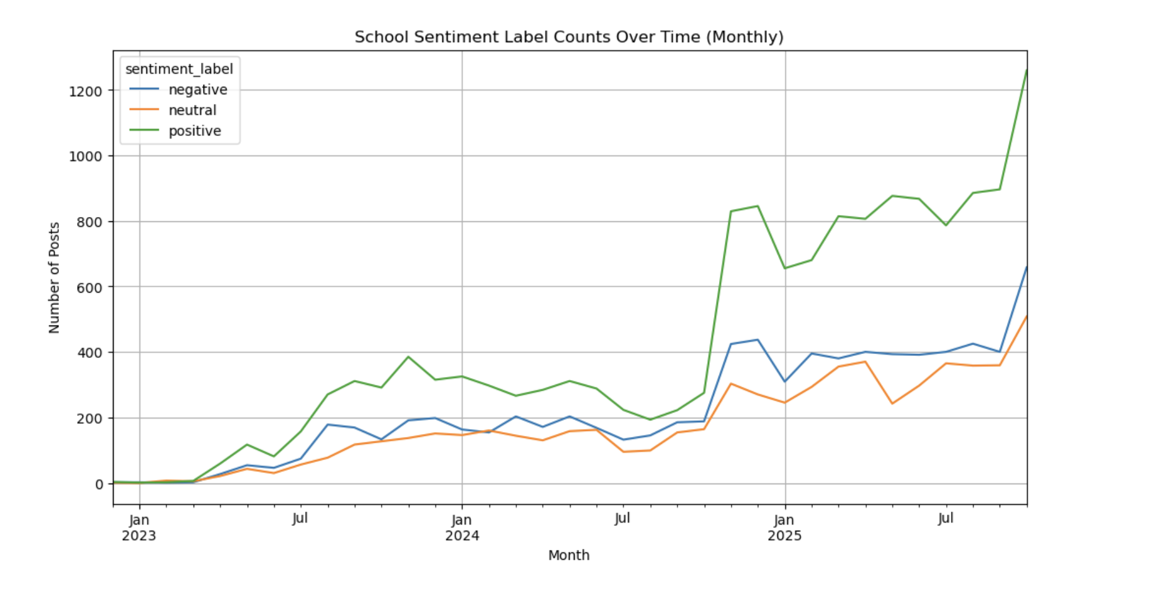
Filter by School related words
Notes:
isabella

Slide 16
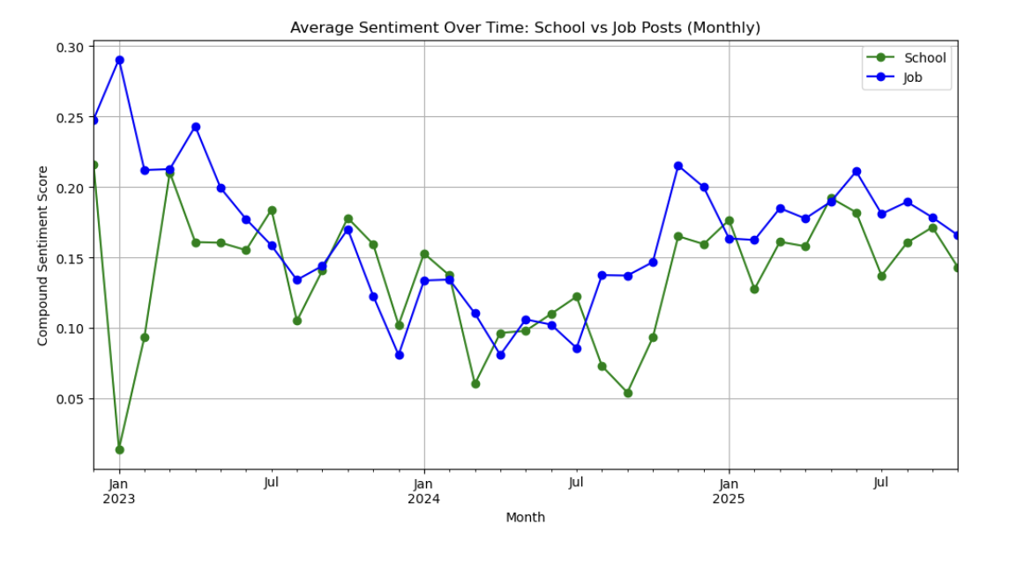
Comparison
Notes:
isabella

Slide 17
Key Takeaways
Overall people are less nervous about AI than we thought they would be
When people are nervous it is mostly focused on AI replacing them, specifically in the workplace
Overtime people are viewing the topic of AI more positively
Maybe as people use AI more they see the advantages of it and enjoy using it more
Notes:
annie

Slide 18

Thanks!
Please keep this slide for attribution
Notes:
isabella

